Slide 1
Cyber Security Awareness
Conducting Workshops and Creating Resources to Educate Vulnerable Groups in Rural/Urban Areas

Slide 2
1. Project Details
Student's Name: 1. Vaishnav Dattatray Nandarge
        2. Harish Nivruti Dhake
Roll Number: 1. 253422161
        2.253422160
Course Name: SYBCA
Department: BCA (Science)
Institution Name: Modern College of Arts, Science, and Commerce, Ganeshkhind-16
Project Guide's Name: Prof. Manasi Jadhav Mam
Date of Submission: [Submission Date]

Slide 3
2.Workshop Agenda
Introduction – Importance of cybersecurity for students.
Common Threats – Bank scams, phishing, fake offers.
How Students Get Trapped – Sharing OTP, PIN, or passwords; social media/app traps.
Prevention Tips – Strong passwords, verify messages, safe browsing, device updates.
Reporting Scams – How to report suspicious messages or calls.
Q&A & Discussion – Students share experiences and ask questions.
Key Takeaways – Recap points and encourage sharing knowledge with peers.

Slide 4
3. Declaration
I, Vaishnav & Harish hereby declare that the project report titled “Cyber Security Awareness: Promoting Safe Digital Practices Across Educational Institutions in Pune and Surrounding Areas” is the result of my independent study and effort, carried out under the valuable guidance of Prof. Manasi Jadhav. This work has not been submitted for any other degree or diploma

Slide 5
4. Acknowledgment
I would like to express my sincere gratitude to my project guide, Prof. Manasi Jadhav, for their continuous support and guidance throughout the project. I also thank the for Sakal NIE (NEWS PAPER IN EDUCATION) is a specialized publication by Sakal Media Group designed to bring current affairs, stories, quizzes, and other educational content into classrooms across Pune and its surrounding zonal areas allowing me to conduct workshops in their , and the participants for their active involvement. My heartfelt thanks to my guidance and colleague for their encouragement and motivation.

Slide 6
5. Abstract
This project emphasizes the importance of cybersecurity awareness among students in an era where digital dependency is growing rapidly.
Workshops were organized across various educational institutions in Pune and adjoining zones to educate students about online security, responsible internet usage, and protection against cyber threats such as phishing, social engineering, and data theft.
Through interactive presentations, demonstrations, and real-life examples, the initiative successfully improved digital literacy and encouraged students to adopt safer online habits.

Slide 7
6. Introduction
Background: The increasing use of technology in education has exposed students to both opportunities and risks.
Many young users lack awareness of basic cybersecurity practices, making them vulnerable to scams, data breaches, and privacy violations.
Purpose and Objectives: This project was designed to bridge that gap by introducing cybersecurity knowledge directly into classrooms.
By conducting workshops and interactive learning sessions across Pune and its surrounding areas, the project aimed to cultivate a culture of safe and responsible digital behavior among students.

Slide 8
Scope of the Project: cyber risks such as data theft, phishing, and cyberbullying.
Objective: The project’s main objective was to introduce cybersecurity education in classrooms and empower students to recognize and prevent common online threats.
Importance:The workshops conducted in multiple schools and colleges around Pune provided participants with a foundation in safe digital practices, ensuring they are equipped to navigate the internet securely and responsibly.

Slide 9
7. Literature Review
The literature review explores existing studies on cyber security education, particularly for vulnerable populations. It covers best practices for delivering effective workshops, the role of community involvement in cyber education, and the impact of awareness programs on reducing cybercrime.
The review identifies gaps in accessible and community-focused cyber security training, which this project aims to address.

Slide 10
8. Methodology
Description of Methods: A workshop-based educational approach was adopted for this project. Sessions were conducted in multiple schools and colleges, using simple and engaging teaching materials such as slides, infographics, and live demonstrations.
Tools Used: Microsoft PowerPoint, Canva, Google Forms, and YouTube resources for visual learning.
Analysis & Interpretation: Participants completed pre- and post-session questionnaires, allowing a measurable comparison of cybersecurity knowledge levels before and after the training.

Slide 11
9. Project Work
Project Activities: Workshop Planning and Preparation: Topics were selected based on common cyber security threats and the needs of the target audience. Materials such as Newapaper, Real examples, and presentations were developed.
Conducting Workshops: The workshops were held at educational content into classrooms across Pune and its surrounding zonal areas . Sessions included live demonstrations, Q&A segments, and interactive activities.
Resource Creation: Educational resources, including a guidebook on cyber security basics and an instructional video series, were created and distributed to participants.

Slide 12
Tools and Technologies Used: Microsoft PowerPoint for presentations, Canva for resource design, and Google Forms for survey data collection.
Challenges and Solutions: Challenges included ensuring participant engagement and addressing varying levels of digital literacy. These were mitigated by simplifying content and using relatable examples.

Slide 13
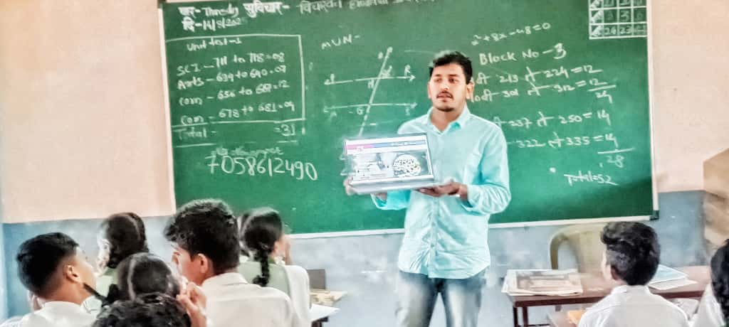
Nowadays, many people become victims of online scams because of a lack of awareness. Scammers use fake messages, calls, and websites to steal personal information and money. Students must be careful while sharing details like OTPs, passwords, or bank information online.

Slide 14
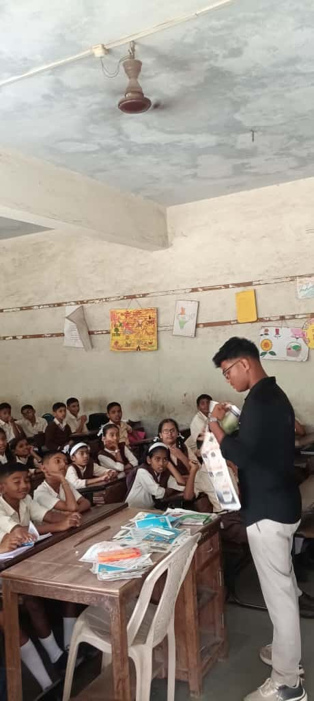
In recent years, several newspapers and online news portals have reported cases where students have become victims of online scams. Reading newspaper articles about online fraud keeps people updated about the latest scams and teaches them to stay alert. Schools can also organize newspaper reading sessions or discussions on cybercrime news to spread awareness more effectively.

Slide 15
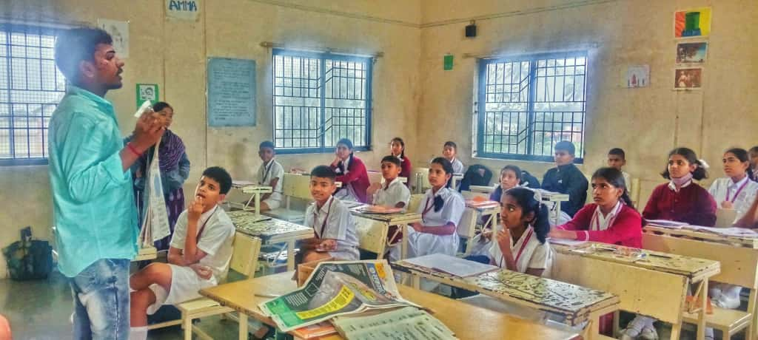
According to multiple reports from The Times of India, Hindustan Times, and Indian Express, hundreds of students across India have lost money or personal data due to fake online schemes. Sharing real cases through newspapers, posters, or school notice boards can help students recognize such threats.

Slide 16
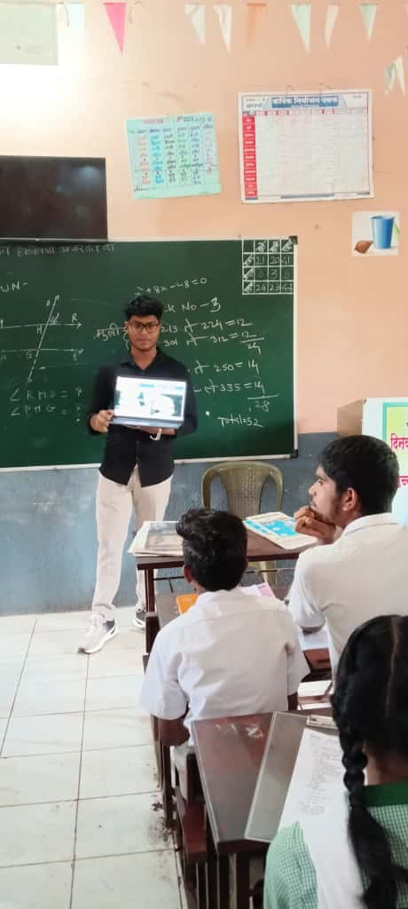
Scammers often attract them through fake links, free gift offers, online games, scholarship forms, or job messages that look genuine. When students click on these links or share personal details, scammers steal their information or install harmful software on their devices.

Slide 17
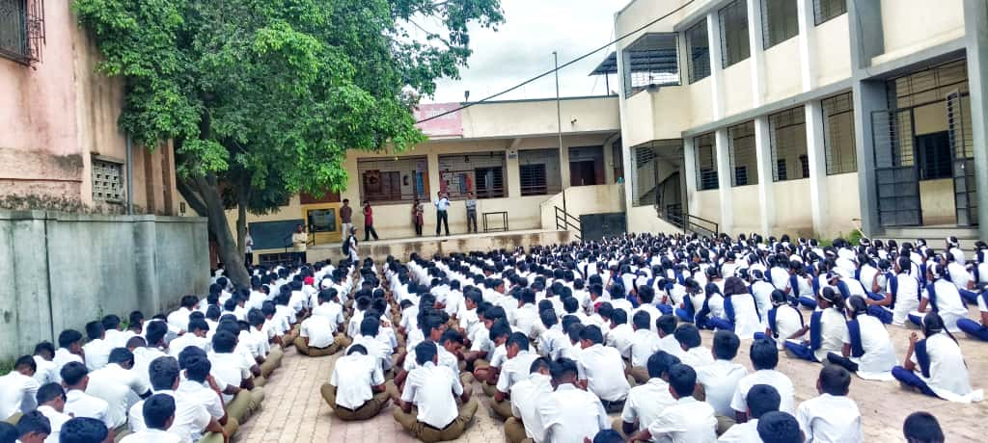
Students often get trapped by fake calls, messages, or offers pretending to be from banks or scholarships.
Scammers ask for OTP, PIN, or account details to steal money.
Precautions: Never share personal banking info, verify messages with your bank, and report suspicious activity immediately.

Slide 18
10. Results and Discussion
Findings: The workshops produced highly positive results — most participants reported significant improvement in their understanding of online safety and digital behavior.
Analysis: The positive feedback suggests that the hands-on and community focused approach was effective. Participants particularly appreciated the practical tips and the interactive format of the workshops.
Implications: Many students expressed that this was their first exposure to structured cybersecurity training.It also suggests that similar initiatives could be scaled to other communities with similar needs.

Slide 19
11. Conclusion
The project successfully fulfilled its objective of spreading cybersecurity awareness among students across Pune and nearby regions.
The initiative’s success suggests that integrating cybersecurity education into regular classroom activities can effectively promote digital safety and responsible online behavior.
Future plans include expanding the workshops to more rural schools and introducing advanced cybersecurity topics

Slide 20
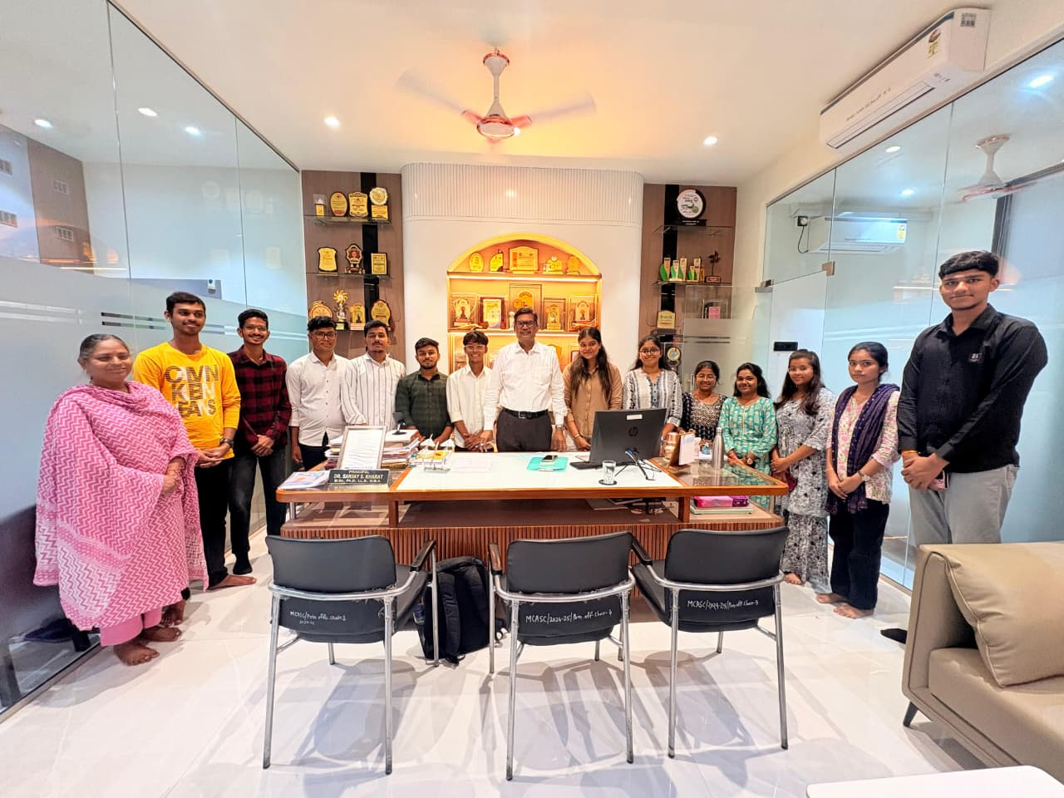
12. Certificates
The other project team with the Principal sir after the successful completion of the project, expressing gratitude for the continuous encouragement, academic support, and valuable guidance provided throughout the duration of the work.

